Slide 1
Session 1
Getting Started
With
C++

Slide 2
Session Objectives
Define the structure of a C++ program
Identify the standard input and output functions
Use comments, width() and endl() functions
Use the editor

Slide 3
Programs
A program can be defined as a set of instructions, which tell
a computer what to do in order to serve the requirements of
the user.
Fundamentally, there are 3 types of programs -
Customized
Applications
Product
Software
System
Software

Slide 4


Evolution Of C++
C++
Bjarne
Stroustrup
1983

Slide 5
C++ Products
There are several C++ products available -
Turbo C++
Borland C++
Zortech C++
AT & T C++
Sun C++

Slide 6
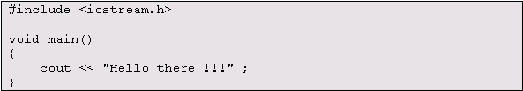
C++ Program Structure
C++ is a structural programming language.
Let us see a simple C++ program -
The above program prints the following message on your screen
Hello there !!!

Slide 7
# include …. statement
The # include statement is the first statement in any C++ program.
It is the most fundamental set of instructions, which is required for
writing any C++ program.
The # notation at the beginning of the statement indicates that the
following instruction is a special instruction to C++.
It establishes a reference to the header file.
It is termed as a preprocessor directive.

Slide 8
The main() function
Functions can be defined as a group of program statements.
The execution of every program in C++ begins with the function
main().
It marks the starting point of execution of the program.
This is a special name recognized by the system under which C++
runs.
The main() function is thus the centralized point for all processing
in a C++ program.

Slide 9
Processing Statements
The statement declaring the main() function is followed by the
symbol ‘{‘.
The right brace ‘}’ indicates the end of the main() function.
All processing statements related to the main() function
should be defined within the curly braces.
The area within the braces is defined as the body of the function.
{
cout << "Hello There !!!" ;
}

Slide 10
Header Files
Header files are used to enable the feature of reusability of program
code.
The function present in a library can be used through a header file
without having access to its actual code structure.
To enable this feature you need to include a declaration of the
function, contained in a .h file, called the header file
# include <iostream.h>

Slide 11
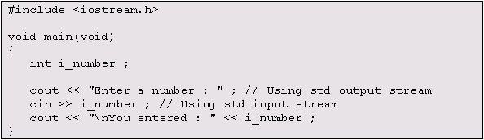
Input / Output
Input is the process of retrieving data from an input device - Keyboard
Output is the process of transmitting data to an output device - Monitor
The I / O operations in C++ involve moving bytes from devices to
memory and vice versa in a consistent and reliable manner.

Slide 12
Standard Input Streams
The following object, in combination with its corresponding insertion
operator performs input in C++.
cin
>>
i_number ;
The insertion operator is used with the cin statement
for the input to be redirected to the memory.
The object corresponds to the standard input stream.

Slide 13
Standard Output Streams
The following object, in combination with its corresponding extraction
operator performs output in C++.
cout
<<
i_number ;
The extraction operator is used with the cout statement
for the output to be redirected to the monitor.
The object corresponds to the standard output stream.

Slide 14
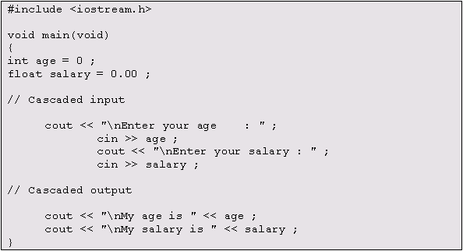
Cascading I / O Operators
The input and output streams can be used in combination and this
method of using I / O streams is referred to as Cascading of I / O
operators.

Slide 15
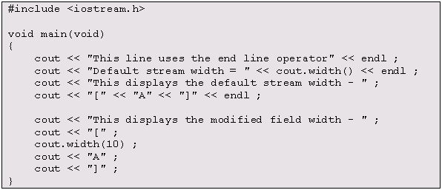
Formatting In C++ - 1
Output in C++ can be formatted using special characters associated
with the cin and cout statements.
Example :

Slide 16

Formatting In C++ - 2
Output :

Slide 17
Formatting Functions In C++ - 1
endl
This function inserts a new line.
It clears the current output stream of any existing data.

Slide 18
Formatting Functions In C++ - 2
width
The width function used by the output stream is used to
indicate the current output stream width.
It is also used to modify the output stream width.

Slide 19
Certain Essentials - 1
The essential components of a program construct are -
Function
Definition
Functions are defined to break up large tasks into smaller tasks

Slide 20
Certain Essentials - 2
Delimiters
Delimiters { … } are used to delimit blocks of code in loops and
functions.

Slide 21
Certain Essentials - 3
Statement
Terminator
Each code instruction in C++ must be terminated with a semi-
colon (;).

Slide 22
Certain Essentials - 4
Comments
Comments can be single line comments (//) or multiple line
comments (/* …… */)

Slide 23
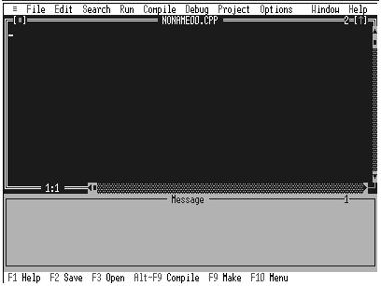
Borland C++ Editor
The Borland C++ interface is a simple character based interface.
A C++ program is first written in the editor, called the source code.

Slide 24
Compilation - 1
The Borland C++ compiler translates the source code to assembly
language that the computer understands.
If a program is too large to be contained in one file, it can be put in
separate files and each of the files can be compiled separately.
The advantage of having separate compilation is that if code in a file
is changed, the entire program need not be recompiled.
The Compile option under the Compile menu compiles the active
editor file.

Slide 25
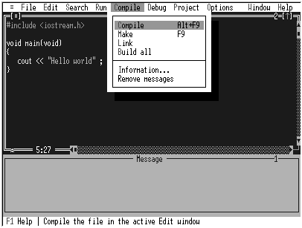
Compilation - 2

Slide 26
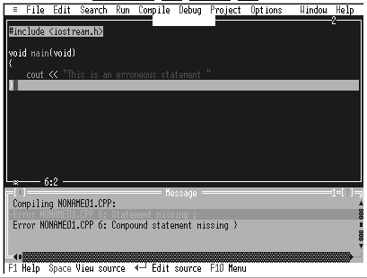
Error Messages
Errors and warnings are generated by the compiler at run time.
All these are displayed in the message window.

Slide 27
Linking - 1
The source code along with support routines from the function
libraries and any other separately compiled functions are linked
together by the C++ linker into an executable code, which is the
.exe file
The Link command in the Compile menu links all the different object
code files as specified in the Include Files option of the Project
menu

Slide 28
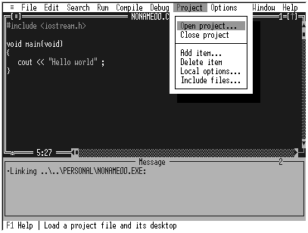
Linking - 2

Slide 29
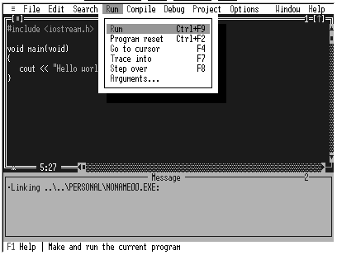
Execution
The Run option from the Run menu carries out the action of
compiling, linking and executing the program.
This can also be done using the Ctrl + F9 key combination.

